Slide 1
Spotify Deep Dive
An analysis of Billboard’s Top 10 Tracks Across Various Dependency Regimes
Brandon Ferro – Chris Newey – Keith Albrecht

Slide 2
MOTIVATION & SUMMARY
Null Hypothesis
Characteristics of popular music, as defined by Billboard’s annual Top 10 Tracks list, will not show statistically significant differences across various dependency regimes
Key Questions
Are there statistically significant differences in popular music preferences across:
time
politics
important societal issues
Conclusions
Preference differences across time are statistically significant
Preference differences across politics are statistically significant
Preference differences across societal issues are not statistically significant

Slide 3
QUESTIONS & DATA
Scope to define:
“Genre” is too broad a preference descriptor, providing little analytical insight; is there a way to quantitatively categorize the things that constitute “genre” instead?
“Across time” is broad and preference is unlikely to change materially year-to-year; group by decade
“Politics” can easily be grouped into R vs. D White House admins
“Import societal issues” is both broad and subjective; narrow by grouping into periods of major war vs. peace-time
Data needed:
Billboard Top 10 tacks with accurate release dates
Music API containing audio feature info on Billboard Top 10 tracks
Lists of historical White House admins, start/end dates of major US wars
Tools used:
Billboard website
Spotify API
Wikipedia

Slide 4
DATA EXPLORATION & CLEANUP
Exploration:
Copy-paste tracks and associated release dates from Billboard website
Research Spotify API to determine what was available and how to call
Locate White House R vs. D admins and major war dates
Cleanup:
Copy-paste unformatted Billboard, Wikipedia data into CSV
Use CSV track data to call Spotify API for audio features
Export Spotify API data to CSV, manually fix release date data
Problems:
No easy-to-find or download file containing Billboard data on web
Format of Billboard website data for 2017-2018 changed, making timely copy-paste into CSV unrealistic
Hoped to cross-reference Billboard API w/ Spotify API, but no longer operational

Slide 5
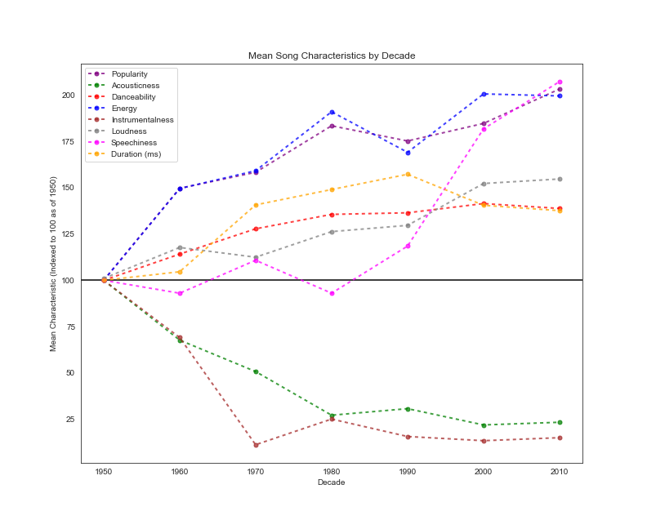
DATA ANALYSIS – Change in Mean Song Characteristics
Call Billboard Top 10 tracks in Spotify API
Append relevant data for each track:
Popularity
Audio feature: Accousticness
Audio feature: Danceability
Audio feature: Energy
Audio feature: Instrumentalness
Audio feature: Loudness
Audio feature: Speechiness
Duration
Group track release date by decade
Group mean of items (A-H) by decade
Index to 100 at start date of 1950

Slide 6
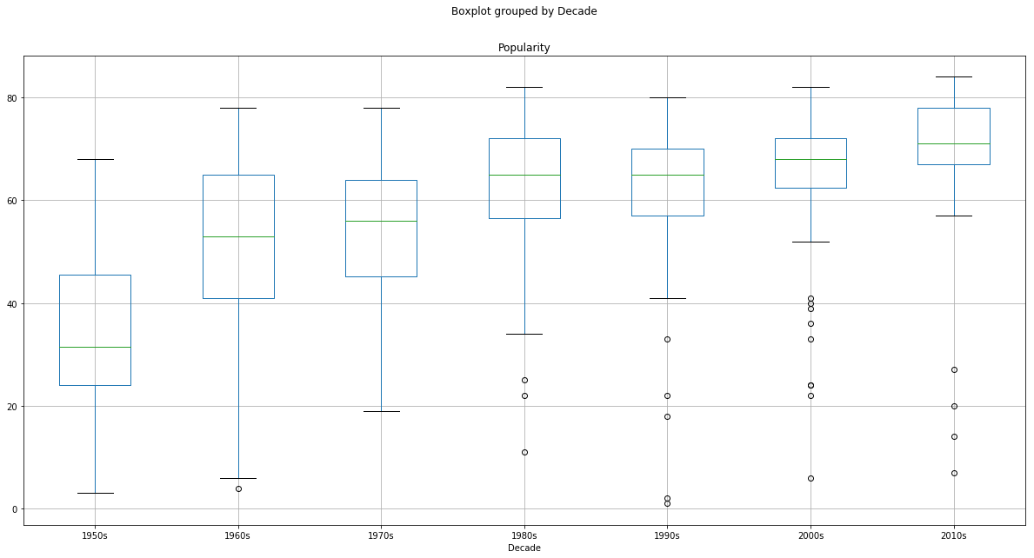
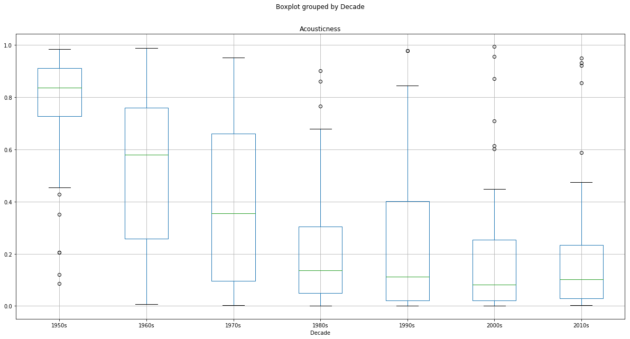
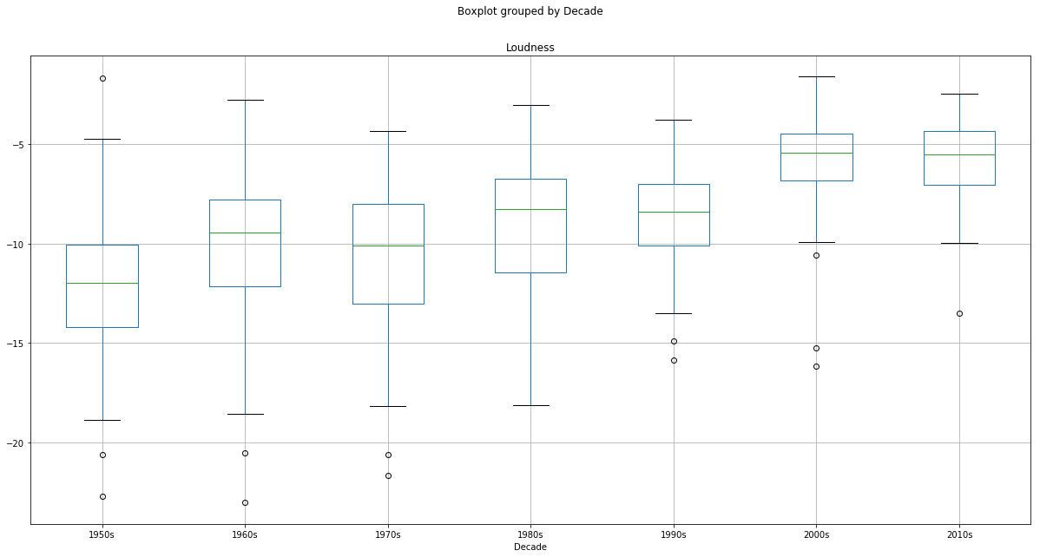
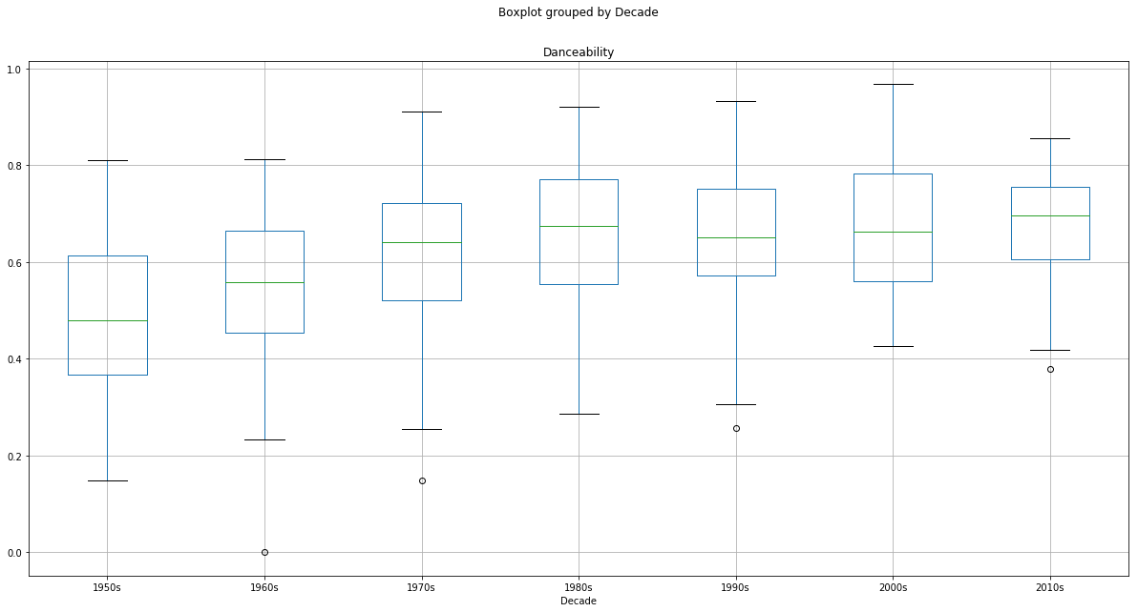
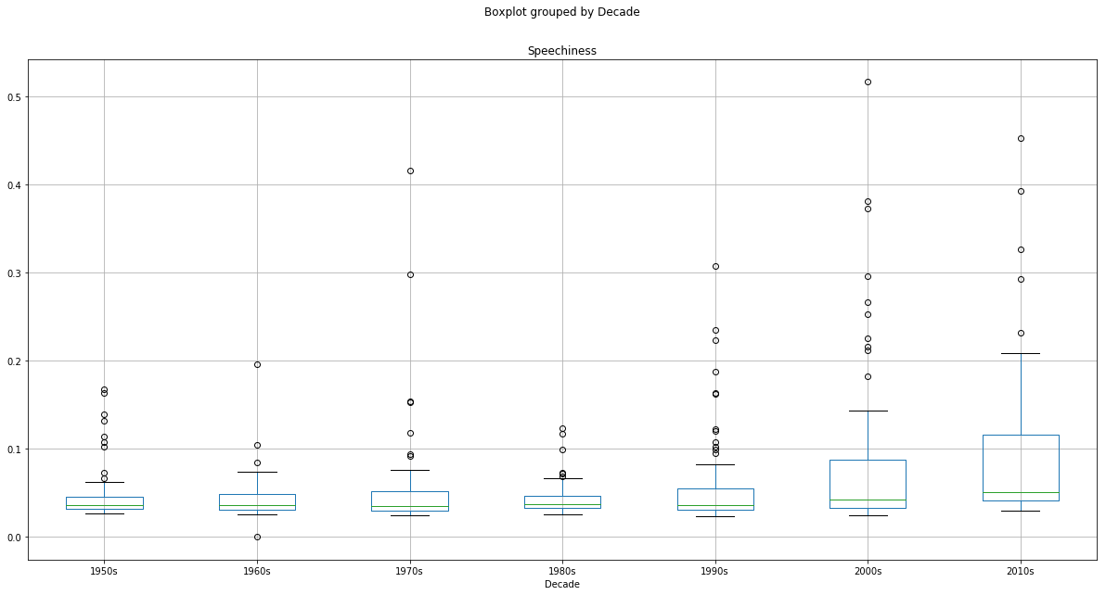
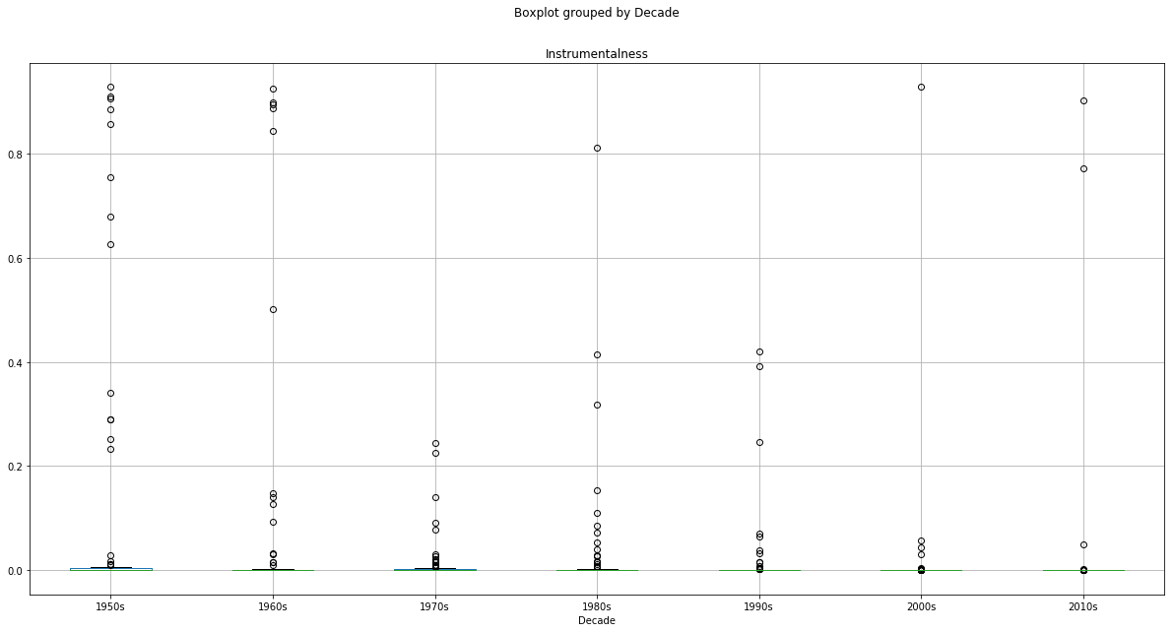
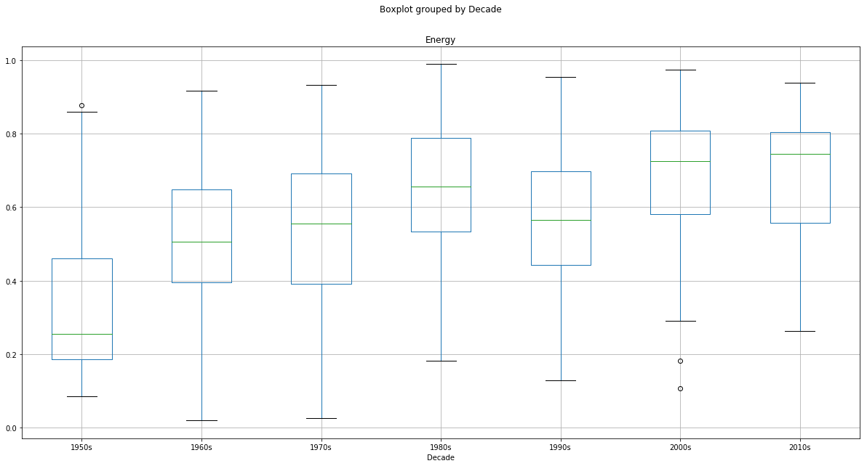
DATA ANALYSIS - Box Plots and ANOVA
statistic=44.02776316160487,
pvalue=7.583118030606852e-44
statistic=62.43245553737173,
pvalue=9.137622636023843e-59
statistic=43.757865000365335,
pvalue=1.2970276425938374e-43
statistic=19.26038775993707,
pvalue=2.1248779540381368e-20
statistic=9.24392991229993,
pvalue=1.1740280683446584e-09
statistic=4.0041488976277435,
pvalue=0.0006201004636514998
statistic=30.276871487542014,
pvalue=2.2825525652530776e-31

Slide 7
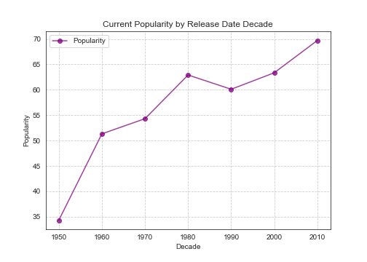
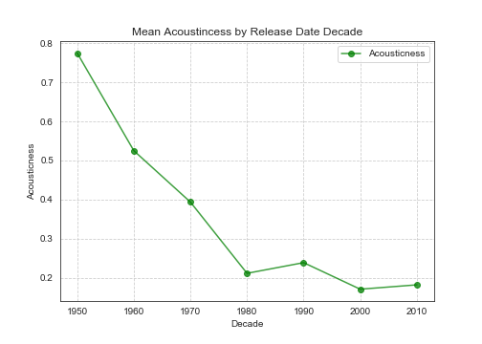
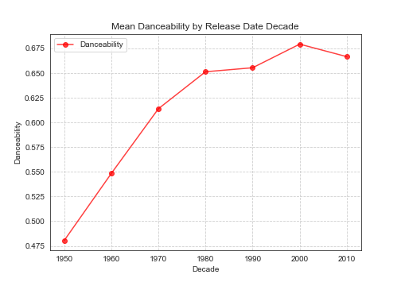
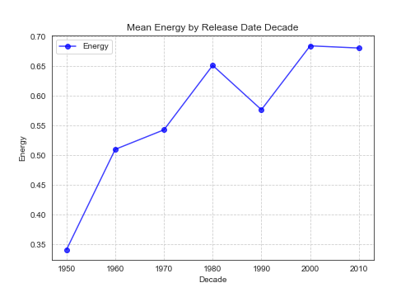
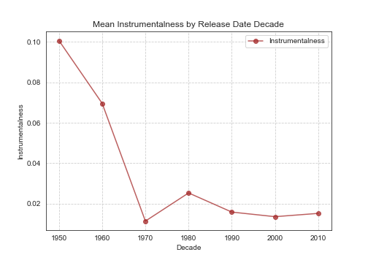
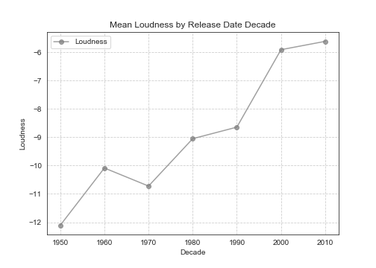
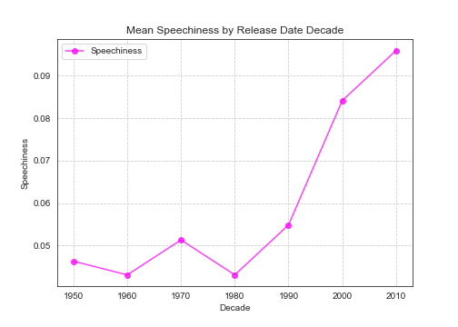
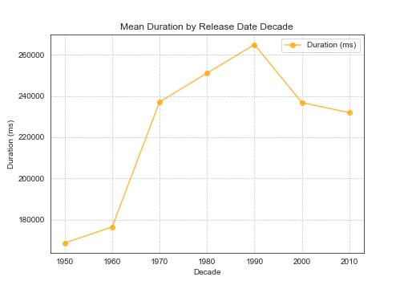
DATA ANALYSIS – Change in Mean Song Characteristics from 1950s
***
***
***
***
***
***
***
***
***
***
***
***
***
***
***
***
***
***
***
***
***
***
***
***
***
***
***
***
***
**
**
**
**
*
***
***
***
***
***
***
***
***
Key:
* = p<0.05
** = p<0.01
*** = p<0.001
**
***

Slide 8
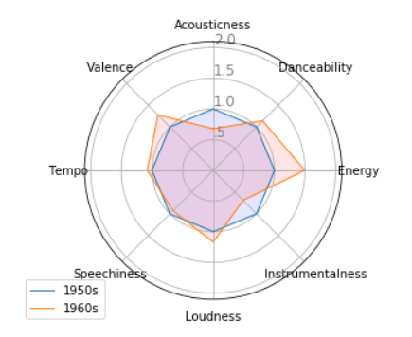
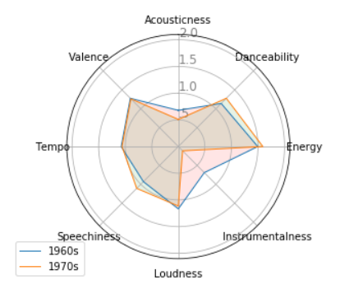
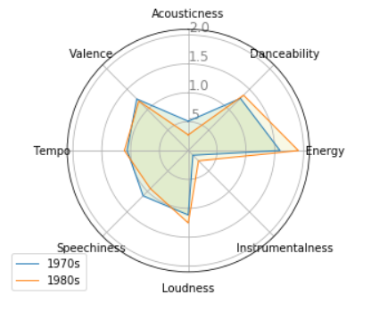
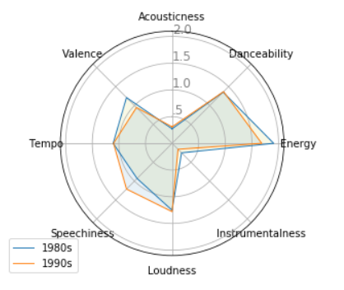
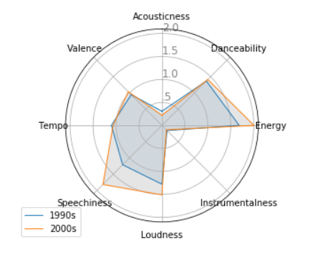
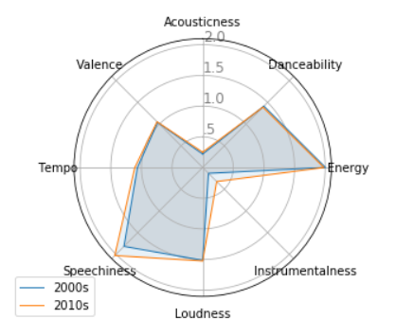
DATA ANALYSIS – Change in Mean Song Characteristics from 1950s

Slide 9
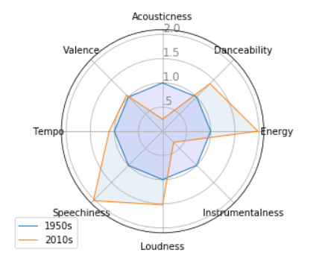
DATA ANALYSIS – Change in Mean Song Characteristics from 1950s

Slide 10
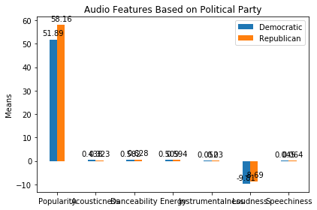
DATA ANALYSIS – Audio Features and Political Party
***
***
*
***
***
***
***
Key:
* = p<0.05
** = p<0.01
*** = p<0.001

Slide 11

DATA ANALYSIS – Song Title Word Cloud
A manual review of Billboard Top 10 song titles for our entire data set highlighted pervasive usage of similar words across time
To confirm, we developed a word cloud
Rank:
‘you’ (n=52)
‘I’ (n = 45)
‘love’ (n=40)
‘me’ (n=29)
‘feat’ (n=26)
‘heart’ (n=7)
Conclusions:
Hit songs get produced when they contain:
Emotion (i.e., ‘love)*
Guest cameo guest appearances (i.e., ‘feat’)

Slide 12
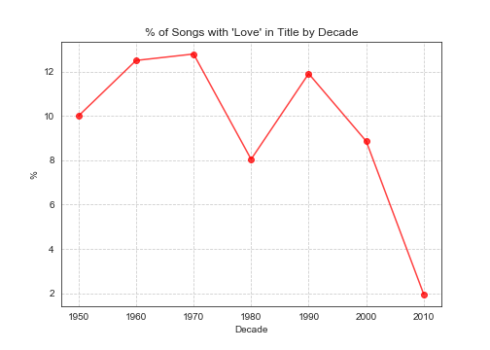
DATA ANALYSIS – REM Lied (Tinder Rules?)
REM claimed in the lyrics of its 1992 hit song “Everybody Hurts”:
If you feel like you're alone
No, no, no, you're not alone
However, our analysis suggests otherwise:
Only 2% of songs released b/t 2010-2016 contain the word ‘Love’
Vs. 8%-12% during the preceding 60 yrs
Conclusion:
Love songs disappearing as Tinder rules the 2010s?

Slide 13
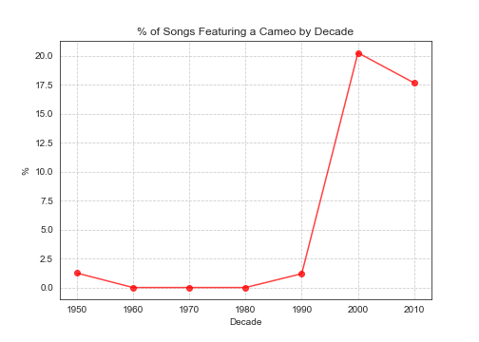
DATA ANALYSIS – Guest Appearance Cameos on the Rise
As noted, song titles including the word ‘feat’ or ‘featuring’ showed up 26x in our data set:
However, prevalence was not evenly distributed across time:
Songs “featuring” other artists were non-existent in the Billboard Top 10 until 1990 but have since exploded
Conclusion:
Popular music preference has increasingly shifted toward tracks featuring guest appearance cameos

Slide 14
POST MORTEM
Problems encountered during analysis:
Inaccurate Spotify release dates
Forced to manually cross-check with Billboard Top 10 data in CSV file
Multiple instances of same track, or of same track performed by different artists, in Spotify API
Call on the first element returned
analysis.append(sp.audio_features(new_uri[i]['tracks']["items"][0]["uri"]))
Originally intended to use Billboard’s annual Top 100 tracks but was too unwieldly for Spotify AP, reducing sample #n of ~660 vs. 6,600

Slide 15
I’m pasting code for you to put in the main Jupyter notebook.
# ------- PART 2: Add plots
# Plot each individual = each line of the data
# The 50s
values=the_50s.flatten().tolist()
values += values[:1]
ax.plot(angles, values, linewidth=1, linestyle='solid', label="1950s")
ax.fill(angles, values, 'b', alpha=0.1)
# The 60s
# values=the_60s.flatten().tolist()
# values += values[:1]
# ax.plot(angles, values, linewidth=1, linestyle='solid', label="1960s")
# ax.fill(angles, values, 'r', alpha=0.1)
# # The 70s
# values=the_70s.flatten().tolist()
# values += values[:1]
# ax.plot(angles, values, linewidth=1, linestyle='solid', label="1970s")
# ax.fill(angles, values, 'g', alpha=0.1)
# # The 80s
# values=the_80s.flatten().tolist()
# values += values[:1]
# ax.plot(angles, values, linewidth=1, linestyle='solid', label="1980s")
# ax.fill(angles, values, 'y', alpha=0.1)
# # The 90s
# values=the_90s.flatten().tolist()
# values += values[:1]
# ax.plot(angles, values, linewidth=1, linestyle='solid', label="1990s")
# ax.fill(angles, values, 'p', alpha=0.1)
# # The 2000s
# values=the_2000s.flatten().tolist()
# values += values[:1]
# ax.plot(angles, values, linewidth=1, linestyle='solid', label="2000s")
# ax.fill(angles, values, 'k', alpha=0.1)
# # The 2010s
values=the_2010s.flatten().tolist()
values += values[:1]
ax.plot(angles, values, linewidth=1, linestyle='solid', label="2010s")
ax.fill(angles, values, 'o', alpha=0.1)
# Add legend
plt.legend(loc='best', bbox_to_anchor=(0.1, 0.1))
# number of variable
categories= ["Acousticness","Danceability","Energy","Instrumentalness","Loudness",
"Speechiness","Tempo","Valence"]
N = len(categories)
# What will be the angle of each axis in the plot? (we divide the plot / number of variable)
angles = [n / float(N) * 2 * pi for n in range(N)]
angles += angles[:1]
# Initialise the spider plot
ax = plt.subplot(111, polar=True)
# If you want the first axis to be on top:
ax.set_theta_offset(pi / 2)
ax.set_theta_direction(-1)
# Draw one axe per variable + add labels labels yet
plt.xticks(angles[:-1], categories)
# Draw ylabels
ax.set_rlabel_position(0)
plt.yticks([.5,1.0,1.5,2.0], [".5","1.0","1.5","2.0"], color="grey", size=12)
plt.ylim(0,2.1)
import matplotlib.pyplot as plt
import numpy as np
from mpl_toolkits.mplot3d import Axes3D
from math import pi
df = group_by_decade_df.mean().reset_index()
df.drop(["Release Date"],axis=1)
# Run this part only once....
df["Acousticness"]=df["Acousticness"]/.77509
df["Danceability"]=df["Danceability"]/.480525
df["Energy"]=df["Energy"]/.341433
df["Instrumentalness"]=df["Instrumentalness"]/.100617
df["Loudness"]=abs(1-((df["Loudness"])/-12.10895))+1
df["Speechiness"]=df["Speechiness"]/.046331
df["Tempo"]=df["Tempo"]/107.576987
df["Valence"]=df["Valence"]/.532334
the_50s = df.drop(["Decade","Release Date","Popularity"],axis=1).iloc[0].values
the_60s = df.drop(["Decade","Release Date","Popularity"],axis=1).iloc[1].values
the_70s = df.drop(["Decade","Release Date","Popularity"],axis=1).iloc[2].values
the_80s = df.drop(["Decade","Release Date","Popularity"],axis=1).iloc[3].values
the_90s = df.drop(["Decade","Release Date","Popularity"],axis=1).iloc[4].values
the_2000s = df.drop(["Decade","Release Date","Popularity"],axis=1).iloc[5].values
the_2010s = df.drop(["Decade","Release Date","Popularity"],axis=1).iloc[6].values

